Slide 1
The Pastons

Slide 2
“There was once a grand and beautiful house… and the people who built it were proud. But now bits of it are crumbling away… and it is no longer grand or beautiful… but full of shadows and memories, and old dusty things…”

Slide 3
“The door to the house is made of solid oak, half a foot thick, and studded with long iron nails... There are ornate decorations around the frame, carved in stone. It was - still is - a grand door. But it is old now, more than 500 years, and the wood is bent and worn and the stone carvings are faded.”

Slide 4
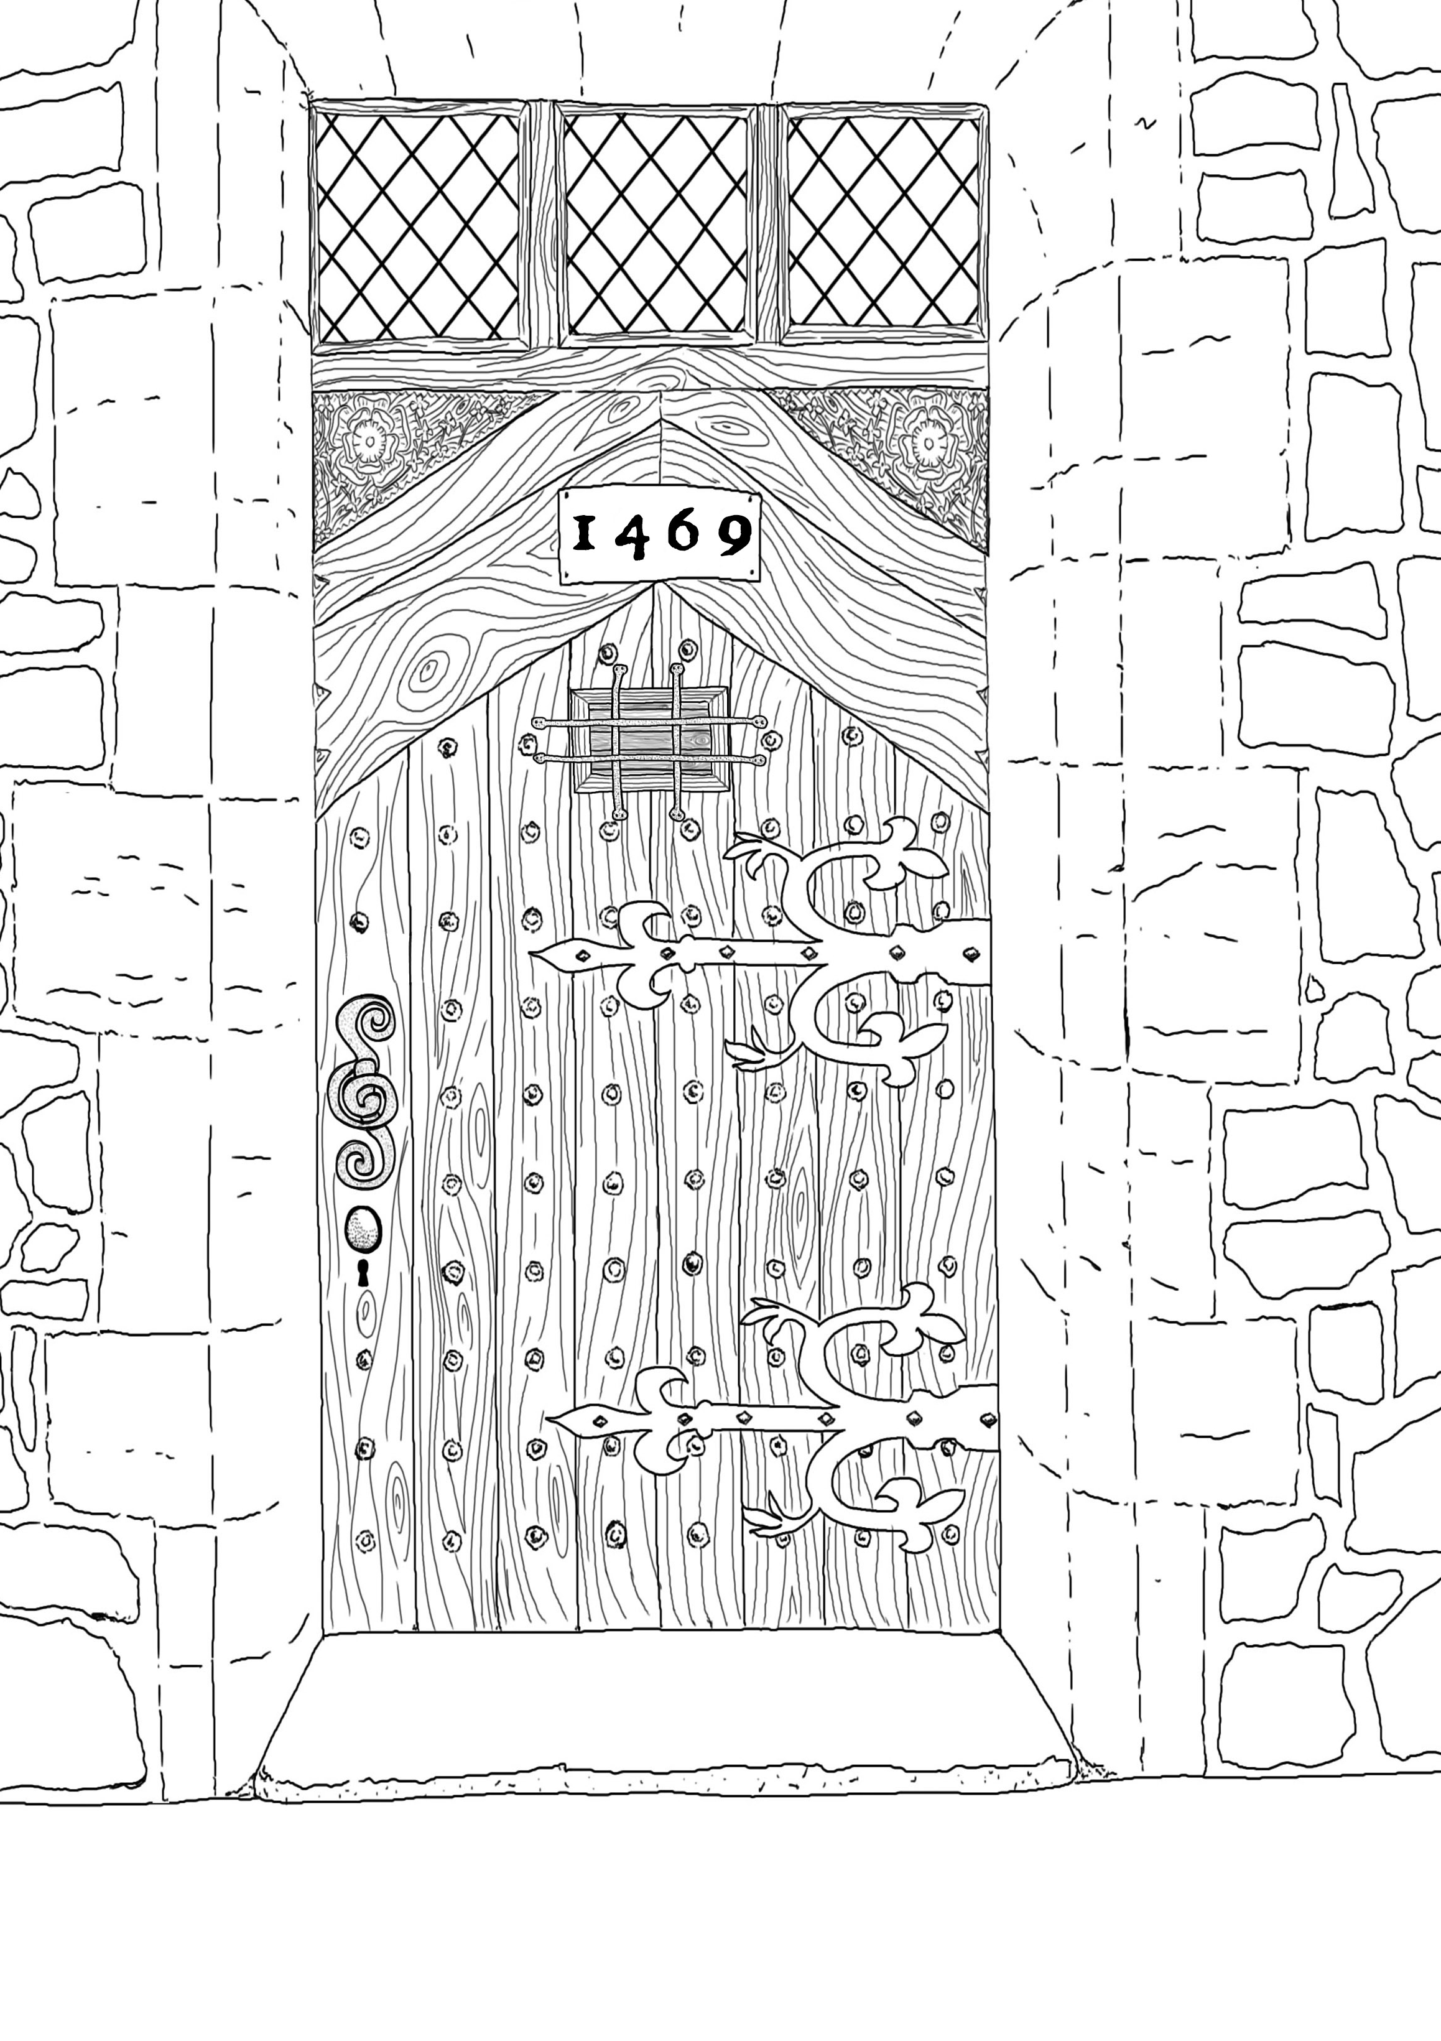

Slide 5
“There are large metal hinges, crooked and bent by years of use, and a small hinged flap called a ‘speakeasy’ - A sort of opening for looking out of.
At the time the door was built, there had been a great deal of trouble in England and people wanted to know who they were opening their doors to.”
Notes:
“Something must have really worried them don’t you think? This door is built for defence, its almost like a small castle door... Makes you wonder what could have worried them so much they went to all this trouble and expense?”
Task - Ask the person next to you: ‘What do you think might have worried them?’

Slide 6
“There is a date above the door... 1469, which you might know was in the middle of one of the most dangerous periods of English history…”

Slide 7


“A terrible civil war was raging all over the country as two great families - the House of York and the House of Lancaster - fought for control of the English throne. The House of York was represented by a white rose, the House of Lancaster by a red rose.”

Slide 8
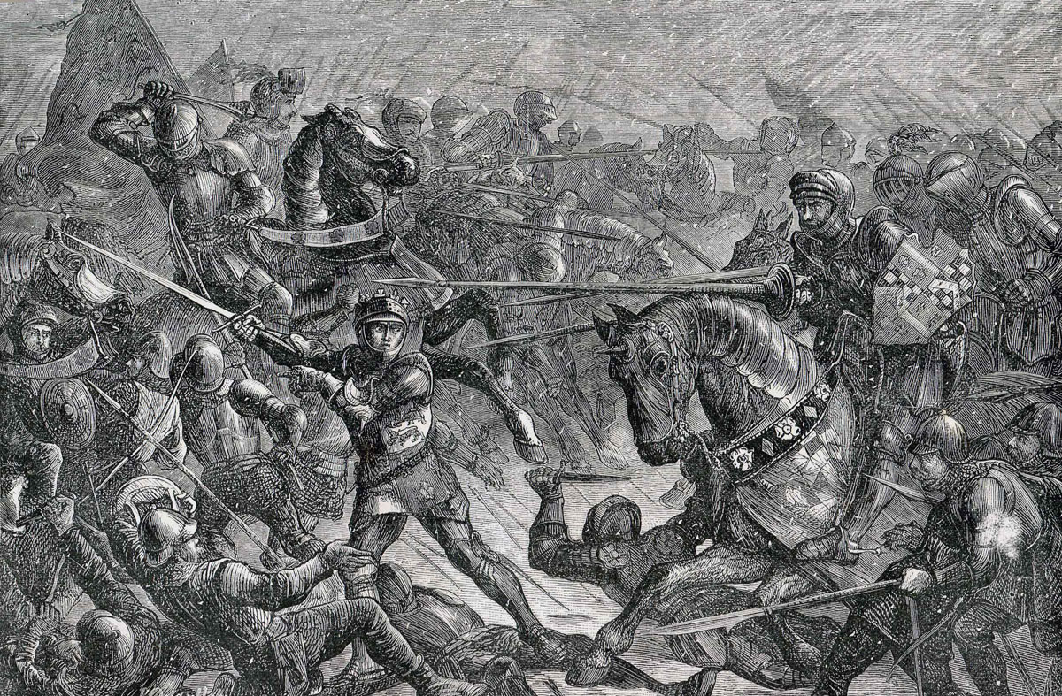

Slide 9
“By 1469 the war had been going for fourteen years and the country was in turmoil. For families, like the ones who lived in this house, it was impossible to feel safe and many took their safety into their own hands, hiring soldiers and building houses with thick walls and strong doors to protect themselves. As you can imagine, they were very worried about security and wanted to make sure they knew who was knocking on their door before opening it.”

Slide 10


